Slide 1
The 76th session of the Executive Council
(EC-76, 27 February – 3 March 2023)
Item 3.1(18) – Draft Recommendation 3.1(18)/1 (EC-76)
Priorities to Address Global and Regional Impacts of Changes in the Cryosphere
76th session of the WMO Executive Council
28 February 2023
Diane Campbell
Co-chair EC-PHORS

Slide 2
Draft Recommendation 3.1(18)/1 (EC-76) Priorities to Address Global and Regional Impacts of Changes in the Cryosphere
Focus on: integrating information on risks arising from the changing global cryosphere with current meteorological, climate, and hydrological monitoring, forecast and prediction products, outlooks and scenarios produced by WMO Members,
Put the spotlight on: capabilities required by Members to respond to the urgency for action,
Connect the dots by: leveraging the cryosphere monitoring and research activities and capabilities conducted by external communities with those of WMO,
Priorities advocated by EC-PHORS following consultations that included P/INFCOM, P/SERCOM, RB representation, C/HCP, C/GCW, Members and partners, CEOS.

Slide 3
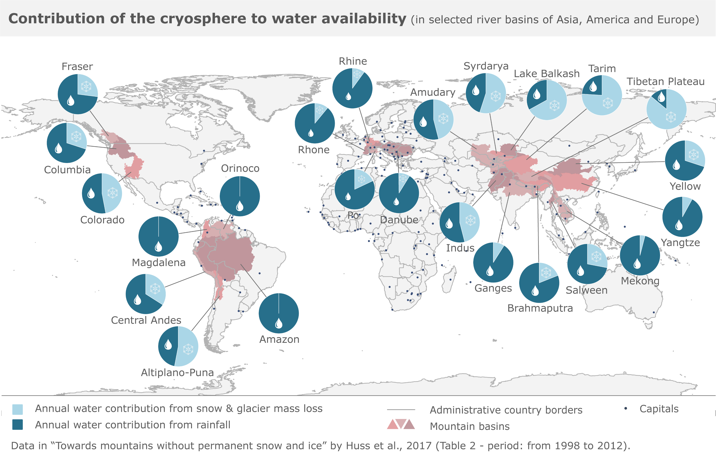
Irreversible changes in the global cryosphere will impact Members’ adaptation strategies…
By 2050 > 50% of the global lowlands irrigation will depend heavily on runoff from the mountain cryosphere,
Changes in the cryosphere have changed frequency, magnitude and location of floods from rain-on-snow, snowmelt floods and glacier-related (50% since 1990),
The amount of carbon in the permafrost today, is at least the same as in the atmosphere,
Greenland and Antarctica ice sheets – contribute about 50% of the sea level rise.
The reliance on cryosphere for water availability in the major river basins of the world
Notes:
IPCC AR6 report indicated with high confidence that:

Slide 4
Structure of document Draft Recommendation 3.1(18)/1 (EC-76)
Draft Recommendation 3.1(18)/1 (EC-76): to recommend to Congress the adoption of five (5) Priorities on global and regional impacts of changes in the cryosphere - included in draft Resolution ##/1 (Cg-19),
Draft Resolution ##/1 (Cg-19) is Annex to draft Recommendation 3.1(18)/1 (EC-76),
Annex to draft Resolution ##/1 (Cg-19) – identifies the five (5) Priorities to Address Global and Regional Impacts of Changes in the Cryosphere and their main actions.
Notes:
Structure of the document

Slide 5
2024-2027 Priorities to Address Global and Regional Impacts of Changes in the Cryosphere
LTGs 1, 2, 3, 4: The urgency of global and regional emerging risks from the changing cryosphere is understood and reflected in the workplans of WMO bodies,
LTGs 1, 2, 3, 4: Collaborative and coordinated technical mechanisms are optimized to support advancing service delivery by Members to address relevant P&HM gaps, all scales,
LTGs 1, 2, 3, 4: Earth system predictions are enhanced through:
closing gaps in polar and high mountain observations;
improving data sharing;
improved numerical models integrating mature research related to cryospheric processes,
LTGs 1, 2, 3, 4, 5: Partnerships/collaboration with research and external stakeholders:
advance knowledge sharing,
amplify the existing capacity to deliver services,
LTGs 1, 2, 3, 5: Antarctica: enhance Members’ collaboration in collecting and sharing observations, conducting research, as well as developing and providing services.
Notes:
List of priorities

Slide 6
EC-76(Doc. 3.1(18) p. 7) recommends that Cg-19 :
Decide to endorse the five high-level priorities identified in the annex as a roadmap for accelerating the integration of cryosphere information into the work of the WMO bodies,
Request the Executive Council to:
Ensure that the five priorities are reflected in the implementation of the WMO Strategic Plan 2024–27 and in the WMO Operating Plan;
Consider updating ToRs of EC-PHORS to serve as a mechanism for engagement and advocacy in the execution of this resolution and as an interface with key partners and stakeholders;
Request INFCOM, SERCOM, RB, RAs, in collaboration with EC-PHORS, to reflect the priorities identified, in their work programmes;
Notes:
Key decisions expected by Cg-19

Slide 7
Thank you

